Slide 1
Traffic Sign Recognition on GTSRB:
From Custom CNNs to ResNet-18 Transfer Learning
CIS 678 – Machine Learning Project Extension
Baseline, CNNs, and ResNet-18 with Explainable Deep Learning
Presented by:
Pavan Kumar Satram
Notes:
This project started as a team project on traffic sign recognition using the GTSRB dataset.
The original work focused on a baseline model and two custom CNNs, mainly to study regularization and overfitting.
My contribution is an extension of that work: I add a ResNet-18 transfer-learning model and introduce explainability tools, like Grad-CAM and a misclassification viewer.
In this talk I’ll briefly recap what was done before, and then focus mainly on the ResNet-18 extension and the insights from it.

Slide 2
Overview of the problem/project
Problem definition
The primary goal of this project is to develop and compare multiple models capable of classifying traffic sign images, ranging from a classical baseline to custom CNNs and a pretrained ResNet-18. The project examines how architecture choices, regularization, and transfer learning affect performance, overfitting, and generalization on GTSRB. Beyond achieving high accuracy, the extension also focuses on understanding model behavior through misclassification analysis and visual explanations of where the network “looks” when making predictions.
General information/idea
This project explores the task of automatically recognizing traffic signs using machine learning and deep learning techniques. Traffic sign recognition is a critical component of modern driver-assistance systems and autonomous vehicles, where accurate interpretation of signs supports safe navigation and decision making. Using the GTSRB dataset—thousands of real-world images across 43 classes—we first build baseline and custom CNN models, then extend the work with a ResNet-18 transfer-learning model and explainability tools such as Grad-CAM.
Notes:
The core problem is: given a traffic sign image from GTSRB, we want to classify it into one of 43 classes reliably.
The original project showed that a regularized CNN already performs well, around 97% accuracy, compared to a weaker linear baseline.
My extension asks: what happens if we go beyond small CNNs and use a deeper, pretrained model like ResNet-18, and then look inside it using explainability tools?
So the goal of my part is both better performance and better understanding of how the model makes its decisions.

Slide 3

Model input-output [1/2 slides]
Can you display some sample (input, output) pairs?
What’s the input (to the model) and its corresponding output ? For the input, each traffic sign image from GTSRB is first preprocessed and then fed into different models. For the classical baseline, the image is resized to a 64×64 grayscale image, flattened into a 4,096-dimensional vector, and then reduced to a 150-dimensional feature vector using PCA. For the deep learning models (the custom CNNs and the ResNet-18 extension), the images are kept as RGB tensors (64×64 for the small CNNs, 224×224 for ResNet-18) so the networks can directly learn spatial patterns from the pixel grid.
For the output, all models ultimately predict one of 43 traffic sign classes. The baseline Ridge regression model produces 43 scores (one per class) and the class with the highest score is chosen as the prediction. The CNNs and ResNet-18 output 43 logits/probabilities, and again the class with the highest value is selected. In all cases, the final output is a single class index in the range 0–42, indicating the predicted traffic sign.
Input | Output
Grayscale 64x64 Image -> PCA -> 150-dim vector | Class 1 (“Speed Limit 30”)
Grayscale 64x64 Image -> PCA -> 150-dim vector | Class 18 (“General Warning Sign”)
Grayscale 64x64 Image -> PCA -> 150-dim vector | Class 13 (“Yield”)
The baseline model mainly sees a reduced numeric feature vector, while the CNNs and ResNet-18 operate directly on the image grid, which is why the deep learning models achieve much higher accuracy and capture richer visual structure.
Notes:
Originally, the project used:
A baseline where images were resized to 64×64, converted to grayscale, flattened, reduced with PCA, and fed to a Ridge regression.
Two custom CNNs that took 64×64 RGB images: a plain CNN and a regularized CNN with BatchNorm, Dropout, and weight decay.
All of these models output a probability over 43 classes, and the argmax is taken as the predicted traffic sign.
This slide is mainly to set the stage; my extension keeps the same input–output idea but changes the backbone to ResNet-18.

Slide 4

Model input-output [2/2 slides]
What’s the input (to the model) and its corresponding output?
For the ResNet-18 model, the input is a 224×224 RGB traffic sign image from the GTSRB dataset. Before feeding it to the network, the image is resized to 224×224 and normalized using the standard ImageNet mean and standard deviation, so it matches the statistics the pretrained ResNet-18 was originally trained on. Like the CNNs, ResNet-18 operates directly on the full spatial structure of the image, allowing it to learn rich features such as edges, shapes, colors, and higher-level patterns.ResNet-18 outputs a 43-dimensional probability distribution, where each value represents the model’s confidence that the image belongs to a particular traffic sign class. The final predicted output is the class with the highest probability (the argmax over the 43 outputs), which corresponds to a class index in the range 0–42.
Can you display some sample (input, output) pairs?
Input | Output
RGB image of a “Speed Limit 50” sign | Class index 2
RGB image of a “Yield” sign | Class index 13
RGB image of a “Triangular warning” sign | Class index 18
Notes:
For ResNet-18, the input is a 224×224 RGB image from GTSRB.
Before feeding it into the model, I:
Resize the image to 224×224,
Convert it to a tensor, and
Apply ImageNet-style normalization (same mean and std that ResNet expects).
The model outputs 43 logits, one for each traffic sign class.
I apply a softmax (implicitly) and take the argmax to get a single predicted class index from 0 to 42, just like the previous models.
So the output space is identical; only the feature extractor has changed to ResNet-18.

Slide 5
Training data and experiment setup
What data you used to train your model(s)?
All the models were trained using the German Traffic Sign Recognition Benchmark (GTSRB) dataset, which contains 39,209 training images, 12,630 test images, 43 distinct traffic sign classes, and real-world variability factors.
For the baseline model, the images were converted to 64×64 grayscale and flattened before applying PCA.
For the plain and regularized CNNs, the images were kept as 64×64 RGB tensors.
For the ResNet-18 extension, the same GTSRB images were resized to 224×224 RGB and normalized using the standard ImageNet mean and standard deviation, with light data augmentation (small rotations and mild color jitter) applied during training.
To support evaluation and hyperparameter tuning, the training set was split into an 85% training subset and a 15% validation subset for all models.
What was your experiment setup?
Baseline (Ridge + PCA):
  Pipeline: grayscale → flatten → StandardScaler → PCA(150) → Ridge
  Hyperparameter: α ∈ {0.1, 0.3, 1, 3, 10}
Plain & Regularized CNNs:
  Input: 64×64 RGB, batch size 128
  Optimizer: Adam, lr = 1e-3, 20 epochs
  Loss: Cross-entropy
  Regularized CNN adds: BatchNorm, Dropout, Weight Decay
ResNet-18 (Extension):
  Pretrained ResNet-18, final layer → 43 classes
  Input: 224×224 RGB, batch size 128
  Adam, lr = 1e-4, weight decay = 1e-4, ~15 epochs
  Cross-entropy loss with light data augmentation
Notes:
All models, including my extension, use the GTSRB dataset:
Around 39k training images, 12.6k test images, 43 classes.
We keep the same split as the original project:
85% of the training data for training, 15% for validation, and a fixed official test set.
For ResNet-18, my setup is:
Input: 224×224 RGB with ImageNet normalization.
Light data augmentation during training: small random rotations and mild colour jitter, to improve robustness.
Optimizer: Adam, learning rate 1e-4, weight decay 1e-4, batch size 128.
Loss: Cross-entropy.
This keeps the evaluation protocol consistent with the previous CNN models so the comparison is fair.

Slide 6
Baseline model performance (1)
How did your baseline model (1) perform?
The baseline model achieved a test accuracy of about 62% on the GTSRB dataset. This means it learned some useful structure, but its performance is clearly limited by the complexity of the data and the linear nature of the classifier. It often misclassified visually similar signs, especially different speed-limit signs and triangular warning signs, because it cannot fully exploit spatial or color patterns. These results provide a clear lower benchmark for comparing the CNN and ResNet-18 models.
What performance metric did you use?
The primary metric for the baseline model was overall classification accuracy on the test set (≈62%). In addition, a classification report (precision, recall, F1-score per class) and a confusion matrix were generated to see which traffic sign categories were most frequently misclassified.
Notes:
The baseline model with PCA + Ridge reaches about 62% test accuracy.
It learns some structure, but it misclassifies many similar signs, like different speed-limit values or triangular warnings.
This model is mainly used as a lower benchmark to highlight how much the CNNs and ResNet-18 improve over a simple linear approach.

Slide 7
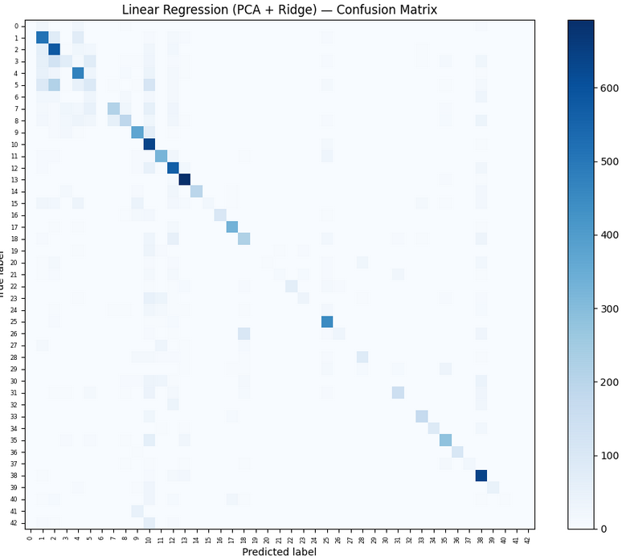
Baseline model performance (1)
This confusion matrix shows that most of the diagonal line is fairly faint, showing that the baseline model correctly classifies relatively few samples.
Additionally, many rows have no strong diagonal, indicating that the model frequently misclassified entire classes.
Off-diagonal clusters show confusion between visually similar signs, such and speed limit signs with similar shapes.
Notes:
In the confusion matrix, the diagonal is faint, which means relatively few correct predictions per class.
Some rows barely have a diagonal at all, showing that whole classes are consistently misclassified.
Off-diagonal blobs show systematic confusion between visually similar signs.
This motivates moving to CNNs and later to ResNet-18.

Slide 8
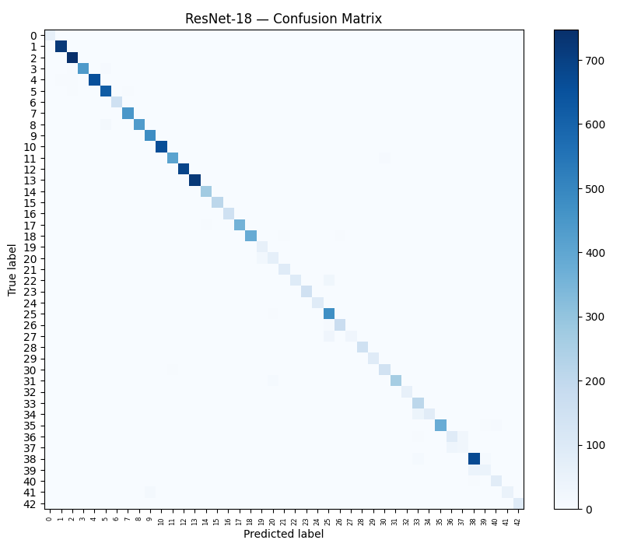
ResNet-18 performance (2)
This confusion matrix shows a strong, dark diagonal, meaning ResNet-18 correctly classifies the vast majority of test images across all 43 classes. Most off-diagonal entries are very faint or empty, indicating only a small number of misclassified samples. The remaining errors are mainly between visually similar signs (for example, different speed-limit values or similar triangular warnings), which are challenging even for humans.
Notes:
This is the confusion matrix for my ResNet-18 model.
Compared to the baseline and even the CNNs, the diagonal here is very dark and continuous, meaning most samples are classified correctly.
Off-diagonal entries are mostly very faint or empty, which shows only a few misclassifications.
The few remaining errors are mainly between extremely similar signs, for example neighbouring speed-limit values or similar triangular warnings.
This visual confirms that ResNet-18 has the best overall generalization among all the models.

Slide 9
Deep Learning model performance (2)
How did your deep learning model (2) perform?
Plain CNN
Test accuracy: ~91–92%
Learns fast but overfits (train ≫ val accuracy)
Confusion matrix shows good overall performance but many errors on visually similar signs
Regularized CNN
Test accuracy: ~97%
BatchNorm, Dropout, Weight Decay reduce overfitting
Cleaner confusion matrix with fewer off-diagonal errors and strong precision/recall
ResNet-18 (Transfer Learning – Extension)
Test accuracy: ~98.9%
Pretrained on ImageNet, then fine-tuned on GTSRB
Very dark diagonal in confusion matrix; remaining errors mostly between extremely similar signs
Overall: going from plain CNN → regularized CNN → ResNet-18 steadily improves accuracy and generalization.
What performance metric did you use?
The primary metric for all deep learning models was overall classification accuracy on the GTSRB test set:
  Plain CNN: ~91–92%
  Regularized CNN: ~97%
  ResNet-18: ~98.9%
In addition to accuracy, we examined precision, recall, and F1-score per class, along with confusion matrices and training vs validation learning curves to analyze class-specific errors and overfitting behavior across the three architectures.
Notes:
Here we compare the three deep learning models:
Plain CNN: about 91–92% test accuracy, but clear overfitting — training accuracy goes to ~100%, validation a bit lower.
Regularized CNN: about 97% test accuracy; BatchNorm, Dropout, and weight decay make training much more stable and reduce overfitting.
ResNet-18 (my extension): about 98.9% test accuracy, which is the best result.
So we see a clear trend:
As we go from custom CNNs to ResNet-18 with transfer learning, both accuracy and robustness improve.
The models all use the same test set, so this is a fair one-to-one comparison.

Slide 10
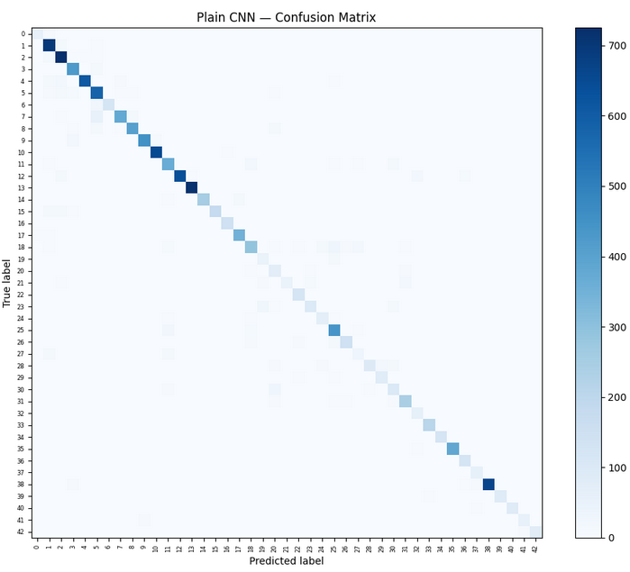
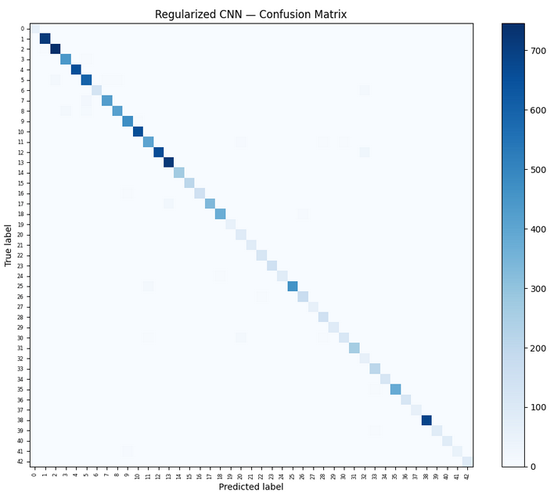
Deep Learning model performance (2)
Plain CNN
The diagonal is mostly strong, but there are still some faint off diagonal values, representing misclassifications. Certain classes with similar shapes or colors are frequently confused, resulting in mild overfitting.
Regularized CNN
The diagonal is brighter and more consistent. Most off diagonal errors are very faint or missing. This indicates fewer misclassifications and that its regularization improves generalization.
Notes:
These confusion matrices are for the Plain CNN and the Regularized CNN.
Plain CNN: diagonal is strong but there are still noticeable off-diagonal errors, especially for visually similar classes.
Regularized CNN: the diagonal becomes cleaner, and the off-diagonal entries are much fainter, showing fewer misclassifications.
This slide shows that regularization helps, and my ResNet-18 extension builds on that by using a deeper, pretrained architecture.

Slide 11
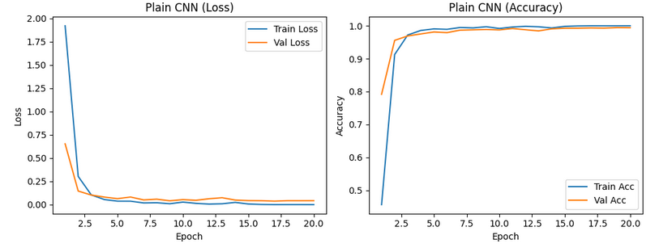
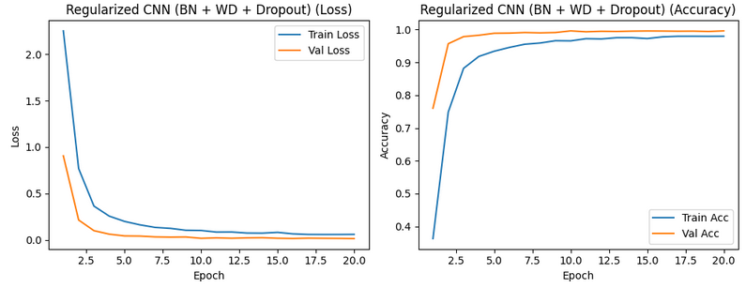
Deep Learning model performance (2)
These four plots visualize how each model learns over time by showing loss and accuracy on both the training set and the validation set across 20 epochs.
Plain CNN
Training loss drops to almost zero, showing the model memorizes the training data
Validation loss decreases initially but then flattens and fluctuates, indicating that the model is not improving on unseen data
Training accuracy reaches ~100%, but validation accuracy stays slightly lower at ~99%
This gap between training and validation curves indicates overfitting
Regularized CNN
Training and validation loss curves are tightly aligned, with both steadily decreasing
Training and validation accuracy rise together and remain very close throughout training
Validation accuracy reaches ~99.6%, even slightly higher than training accuracy early on, showing stable and well regularized learning
Notes:
These are the learning curves for the Plain CNN and the Regularized CNN.
Plain CNN: training loss goes almost to zero and training accuracy to 100%, while validation curves level off → overfitting.
Regularized CNN: training and validation curves stay much closer, which means better generalization.
This analysis motivated trying a stronger but still well-behaved model, which is what led to my ResNet-18 extension.

Slide 12
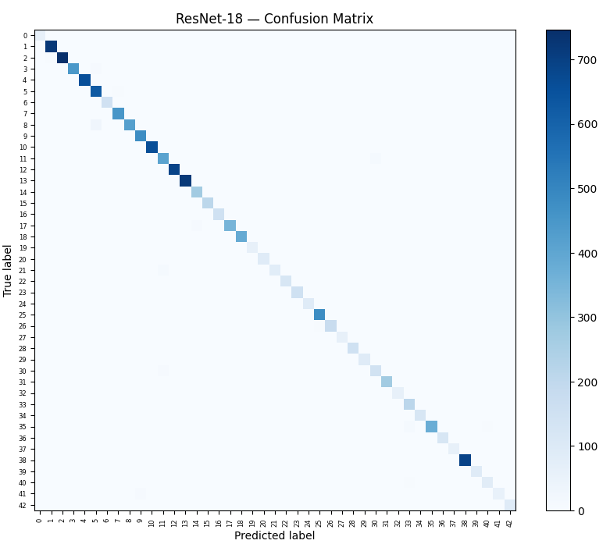
Deep Learning model performance (3)
ResNet-18 (Transfer Learning – Extension)
The confusion matrix for ResNet-18 shows a very strong, dark diagonal, meaning the model correctly classifies almost all samples across all 43 classes. Most off-diagonal cells are empty or extremely faint, indicating only a few misclassifications.
The remaining mistakes mostly occur between visually very similar signs (for example, different speed-limit values or similar triangular warnings), confirming that ResNet-18 provides the best overall accuracy and generalization among all models in this project.
Notes:
This slide is focused on ResNet-18, the model I added.
ResNet-18 is a deeper residual network pretrained on ImageNet, which gives us a strong starting point for feature extraction.
I adapted it to GTSRB by replacing the final fully connected layer with a 43-class output layer and then fine-tuning on the traffic sign data.
Because of the pretrained weights and residual connections, ResNet-18 learns very good features for subtle differences between traffic signs, which explains its higher accuracy and cleaner confusion matrix.

Slide 13
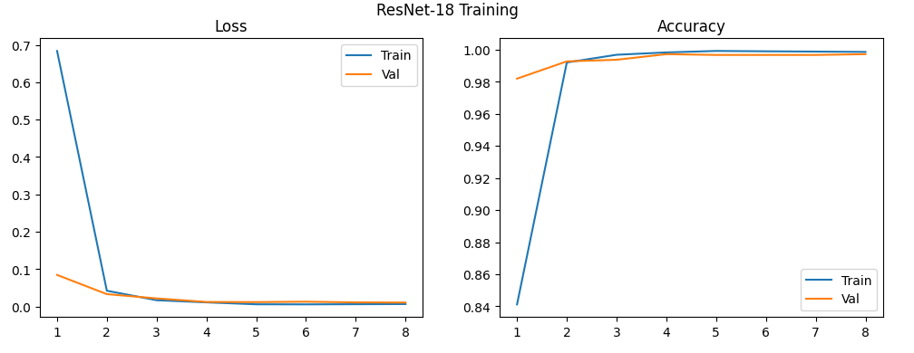
Deep Learning model performance (2)
These plots show training/validation curves and the confusion matrix for the ResNet-18 model fine-tuned on GTSRB.
ResNet-18 (Transfer Learning)
Train and validation loss/accuracy curves stay very close, with only a small gap → mild overfitting and strong generalization
Validation accuracy stabilizes around ~98–99%
The confusion matrix has a very dark diagonal and only a few faint off-diagonal entries
Remaining mistakes are mainly between extremely similar signs (e.g., nearby speed-limit values)
Overall, ResNet-18 is the best-performing model in the project, combining high accuracy with stable training behavior.
Notes:
Here we see ResNet-18’s training and validation curves.
They remain close throughout training, with validation accuracy stabilizing around 98–99%.
This shows that the model is learning effectively without severe overfitting, which matches the strong test accuracy and confusion matrix we saw earlier.

Slide 14
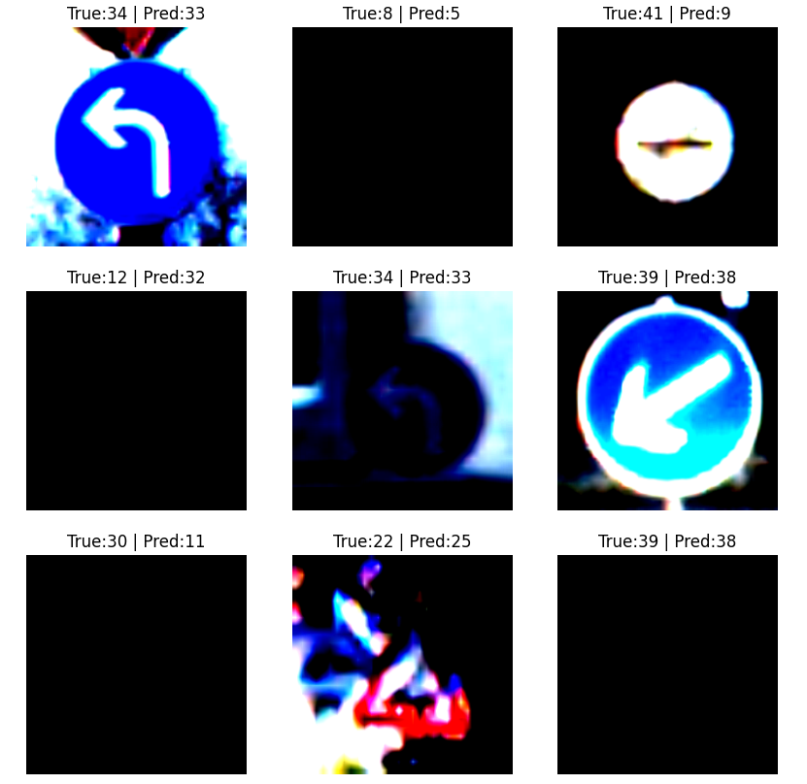
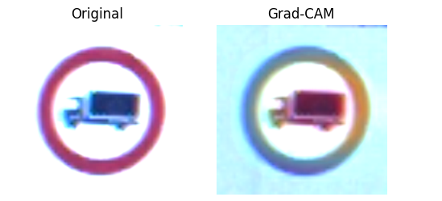
Error Analysis & Explainability (ResNet-18)
What does Grad-CAM show?
Highlights where ResNet-18 is “looking” in the image.
For correct predictions, heatmaps focus on the sign area (digits, icon, border).
For some mistakes, attention drifts to the border only or even the background, helping explain misclassifications.
What do misclassified examples tell us?
Confusions between very similar signs (e.g., nearby speed limits, similar triangular warnings).
Errors often occur on images with blur, occlusion, or bad lighting.
Shows that most remaining errors are on very hard or ambiguous cases, even though overall accuracy is high.
Notes:
Beyond accuracy, I wanted to understand how ResNet-18 makes its decisions.
I added two tools in this extension:
A misclassification viewer that shows the image, the true label, and the predicted label.
Grad-CAM, which highlights the regions in the image that contributed most to the prediction.
In correctly classified images, Grad-CAM usually focuses on the traffic sign region: digits, icons, or the border.
In misclassified images, the heatmaps sometimes highlight only part of the sign or even parts of the background, which helps explain why the model gets confused.
The misclassified examples are often very hard cases: blurred, occluded, or extremely similar signs, which suggests that remaining errors are close to the limits of the data itself.

Slide 15
Suggestions/Recommendations
Any recommendations about future work?
Try other architectures (e.g., ResNet-34, MobileNet) and compare to ResNet-18
Use stronger data augmentation and more systematic hyperparameter tuning
Explore ensembles of Regularized CNN + ResNet-18
Add more explainability methods beyond Grad-CAM
Build a simple real-time traffic sign recognition demo (webcam / video)
Notes:
Based on the ResNet-18 extension, there are several natural next steps:
Try other architectures, like ResNet-34 or MobileNet, to trade off accuracy vs efficiency.
Use stronger data augmentation and more systematic hyperparameter tuning, for example different learning-rate schedules.
Explore ensembles, combining the Regularized CNN with ResNet-18.
Build a simple real-time demo with webcam or video input to see how the model behaves in a more realistic setting.
Extend explainability beyond Grad-CAM to cross-check how the model reasons about different signs.

Slide 16
Project learning/task assignments
Original project (team)
  Implemented baseline (PCA + Ridge) and Plain / Regularized CNNs
  Generated initial metrics, confusion matrices, and learning curves
Extension (my work)
  Fine-tuned ResNet-18 on GTSRB with data augmentation
  Added misclassification viewer and Grad-CAM explanations
  Compared all models and wrote the extension report + updated PPT
Notes:
The original project work included:
Implementing the baseline (PCA + Ridge) and the Plain / Regularized CNNs.
Generating initial metrics, confusion matrices, and learning curves.
My contribution in this extension was to:
Integrate and fine-tune ResNet-18 on GTSRB using transfer learning.
Implement the 224×224 + ImageNet normalization data pipeline with light augmentation.
Evaluate ResNet-18 and compare it fairly against the baseline and CNN models using the same test set.
Add error analysis tools: a misclassification viewer and Grad-CAM visual explanations.
And finally, write the extension report and update this presentation to integrate the new results.

Slide 17
QA

